Slide 1
ACT on Global
Warming/Ecocide
Martin Wilks
Robyn D. Walser
Paul Atkins
ACBS - Dublin 2019
Notes:
Framed by prosocial
Joanna Macey’s work - the ‘Great Turning’
Mapping her 4 stage cyclical process onto matrix (we already do this stuff!)
The integral perspective -
James Lovelock’s Gaia hypothesis as introduction to systems thinking
Shifting perspectives for second spin around matrix -
I, here, now - goes to - Us, here, now
Introducing Elinor Ostrom’s evolutionary design principles and Rittel’s ‘wicked’ problems as cautionary guiding principles before leaping to committed actions (OR wallowing in despair)
The Deep Adaptation perspective

Slide 2
Disclosures (no support):
ACBS Dublin 2019
Martin Wilks, Robyn Walser, Paul Atkins
I have not received and will not receive any commercial support related to this presentation or the work presented in this presentation.

Slide 3
Workshop Intention
Participants will:
Express through experiential exercises their current relationships with nature
Explore ‘the ecological self’
Set intentions/committed actions in the service of ecological valuing.
.

Slide 4
What we would ask of the participants
Willingness to take part in an experiential inquiry
Bring ‘beginners mind’ to new concepts & perspectives
Allow yourself to feel how you feel
Take care of yourself and the others

Slide 5
Joy
Notes:
Each of the Joy slides will be posted for about 5 secs each
80 secs total

Slide 6
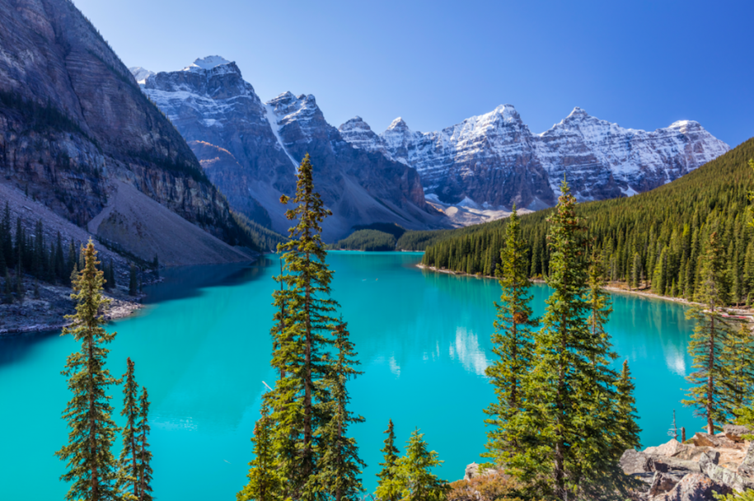

Slide 8
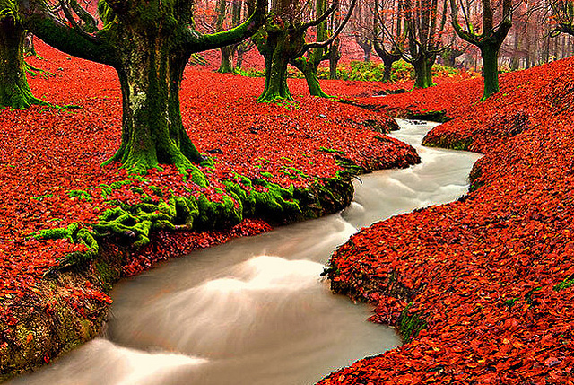

Slide 9
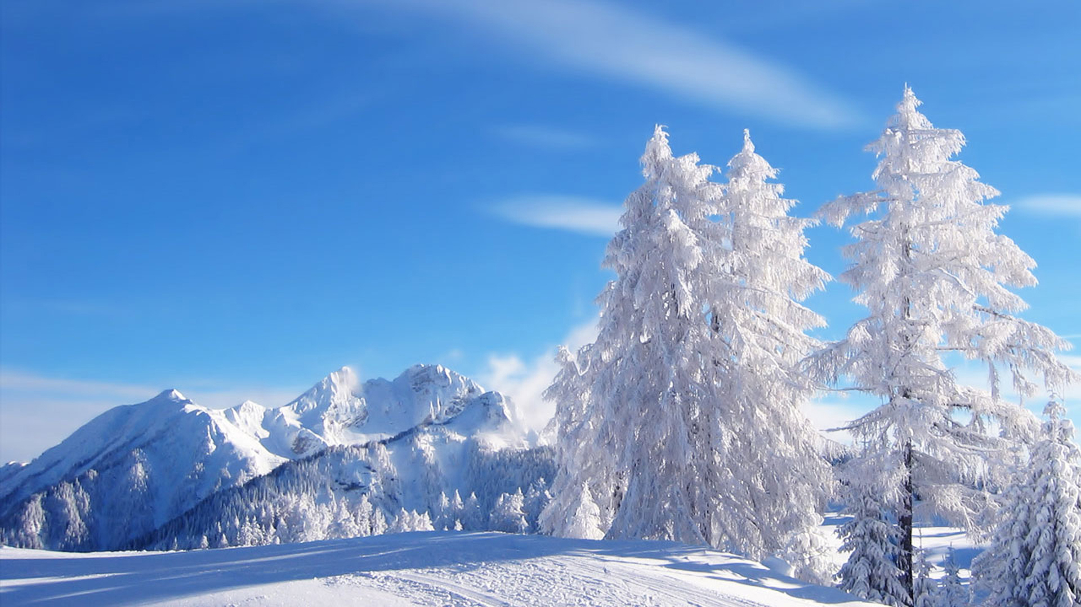

Slide 10
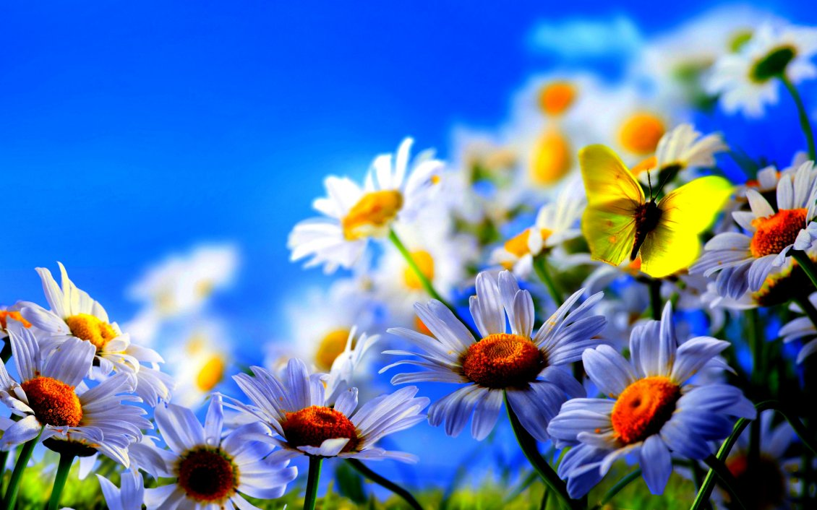

Slide 11
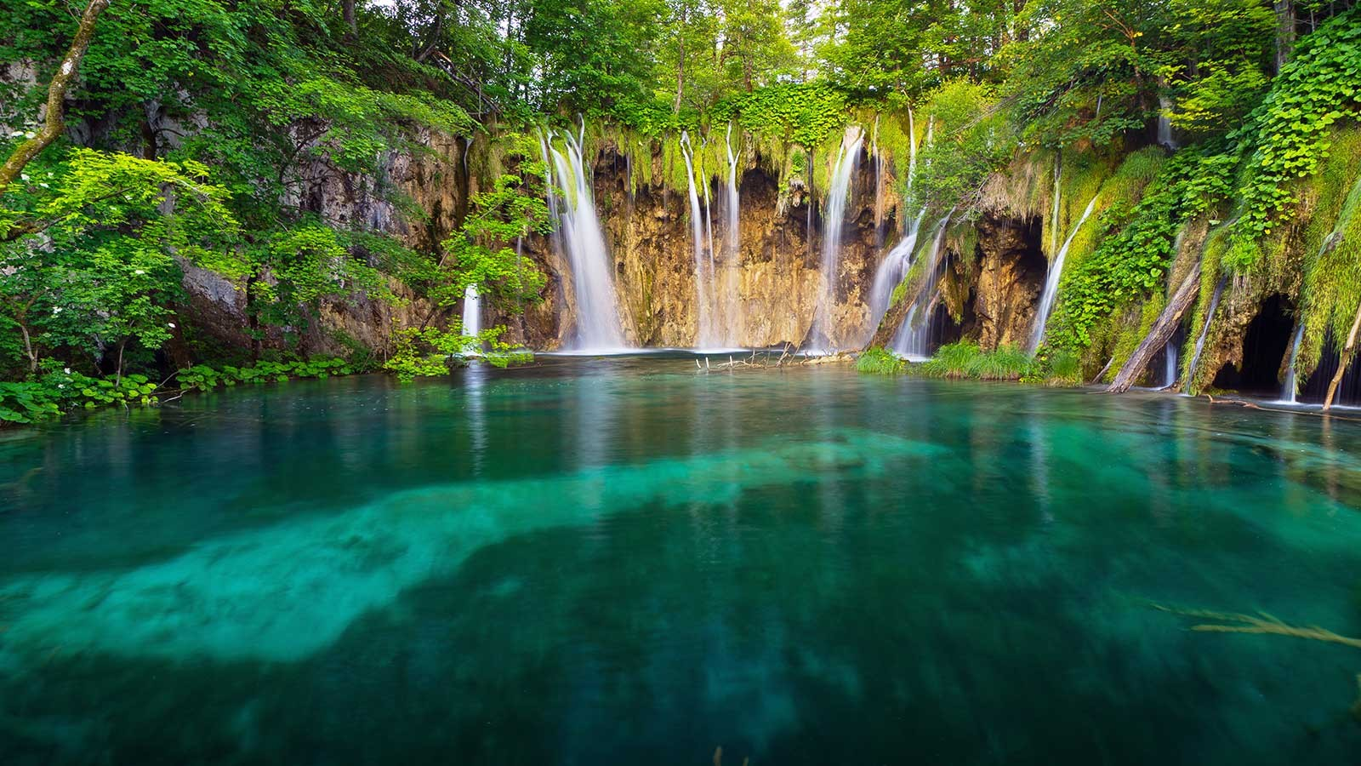

Slide 12
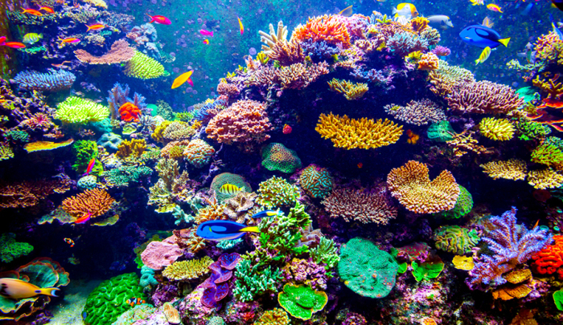

Slide 13
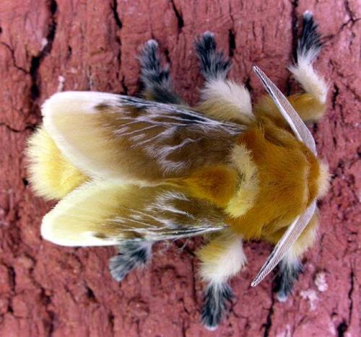

Slide 14
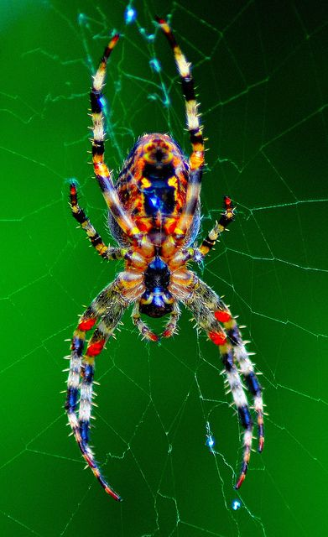

Slide 15
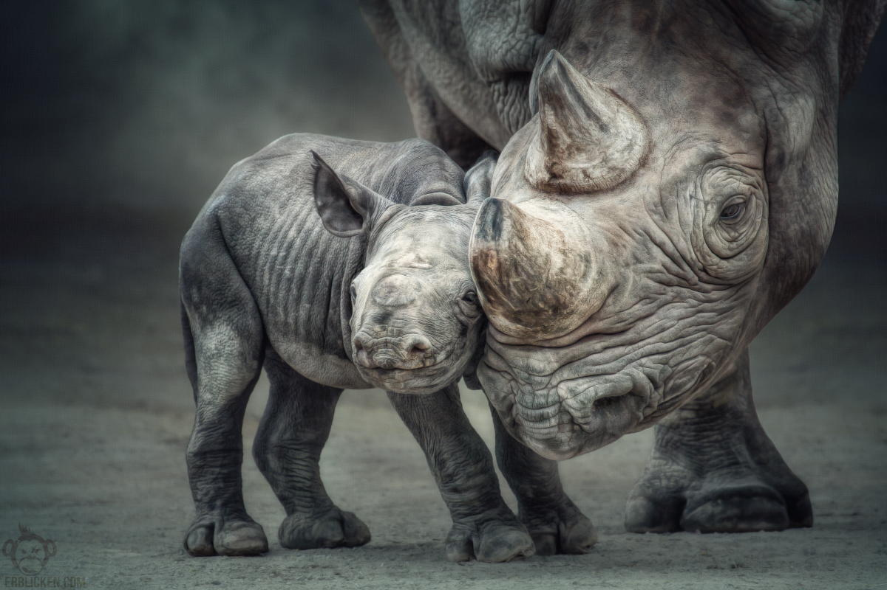

Slide 16
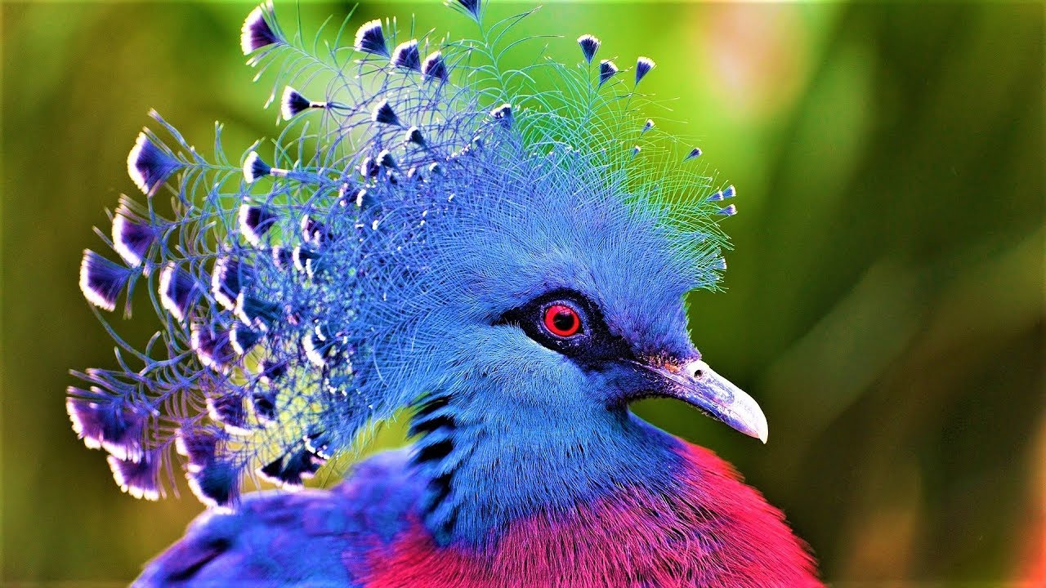

Slide 17
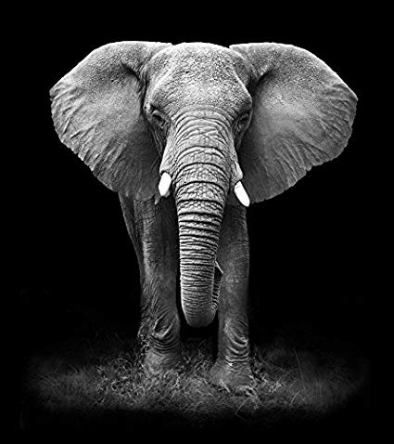

Slide 18
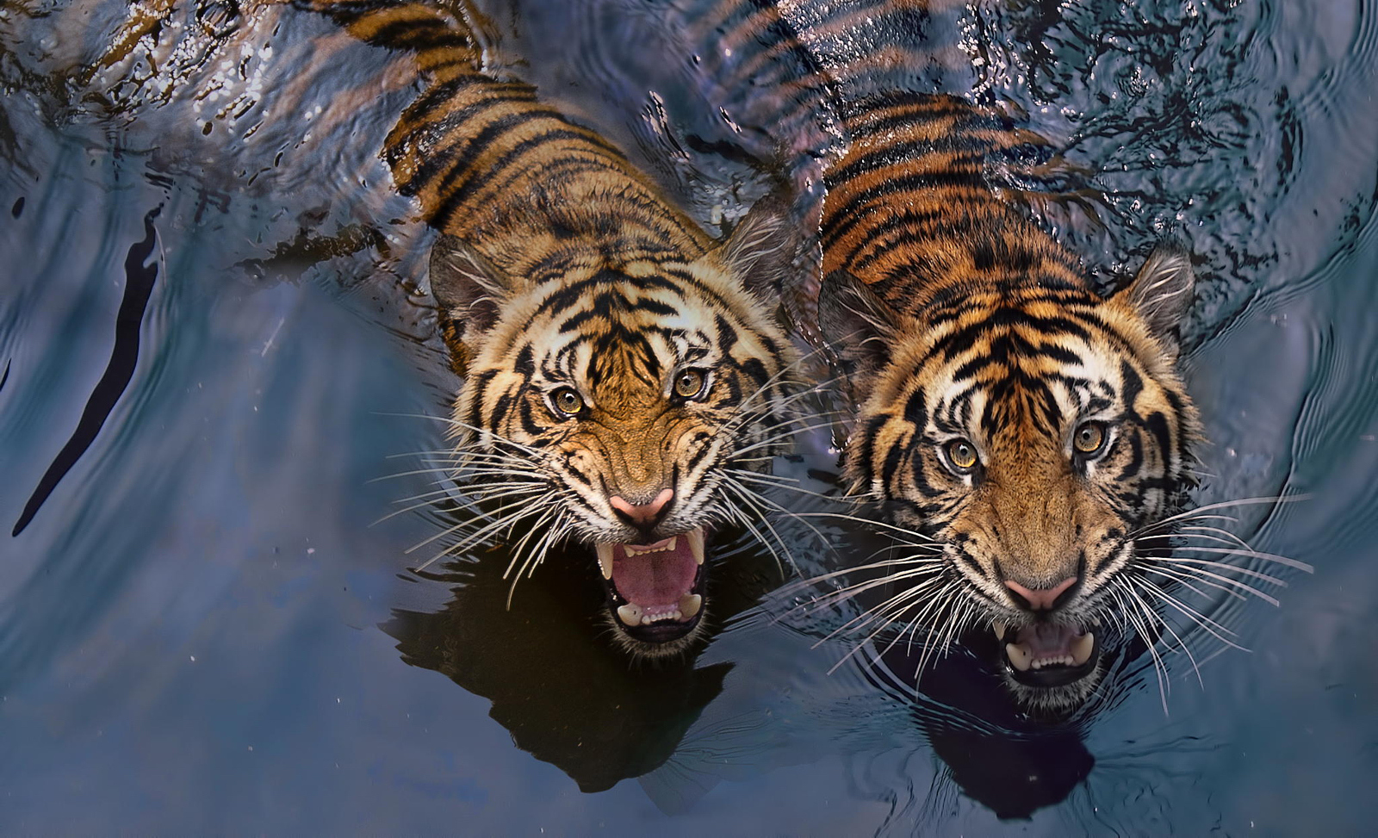

Slide 19
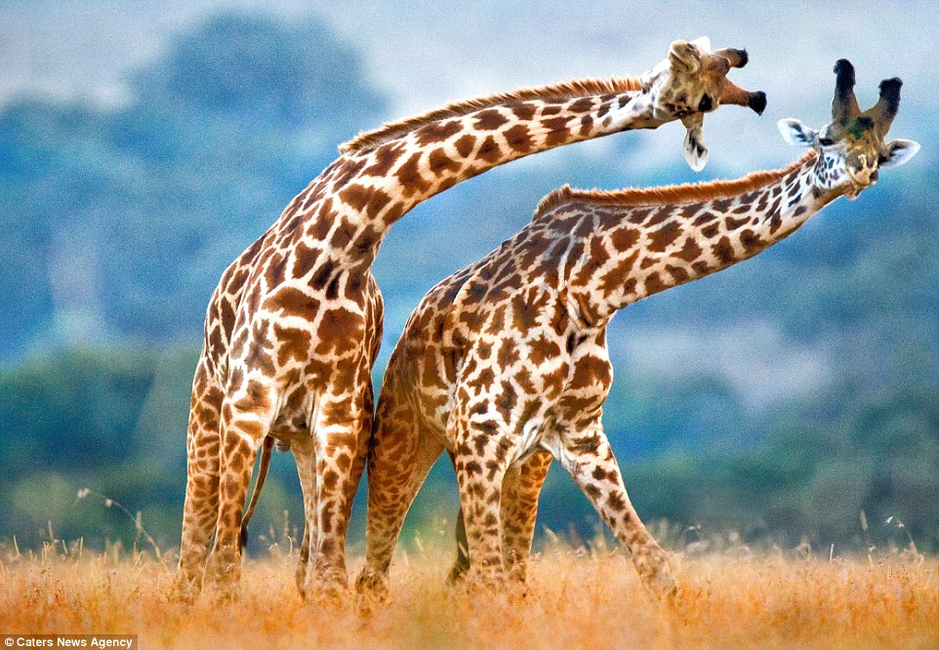

Slide 20
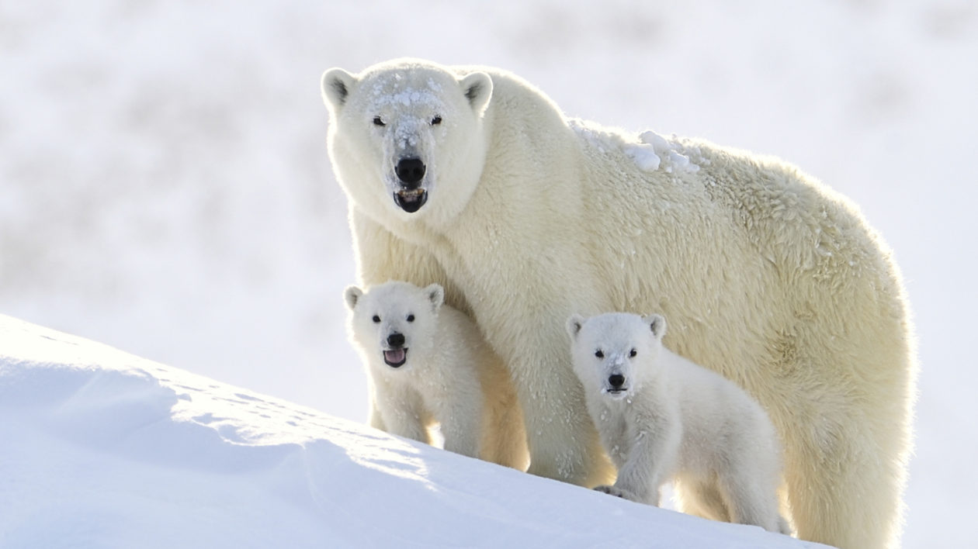

Slide 21
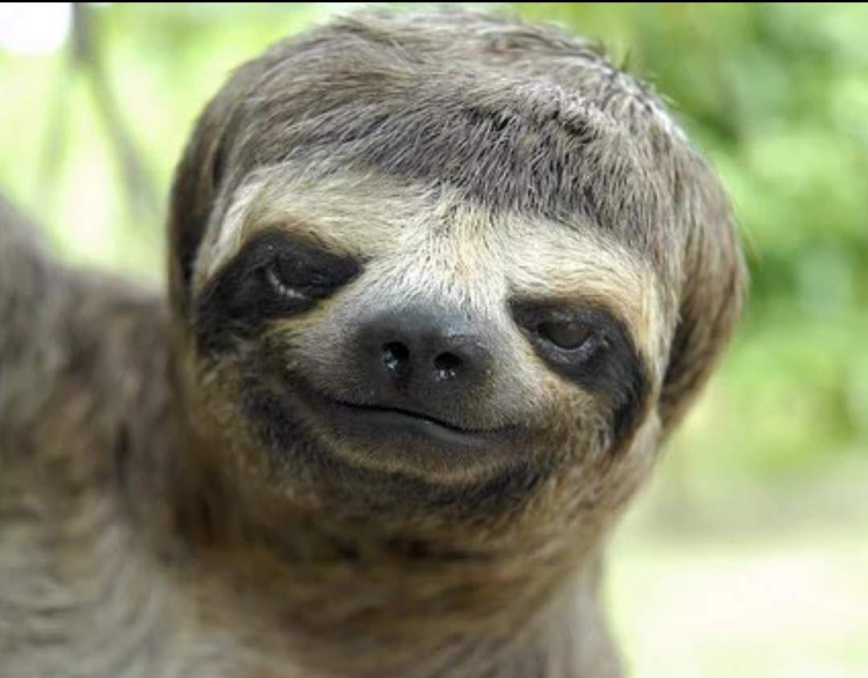

Slide 22
Your Joy
Notes:
Brief guided visualization and share with another

Slide 23
Despair
Notes:
Each of the despair slides will post for about 5 secs
80 secs total although a few more seconds may be given for the slides with writing on them.

Slide 24
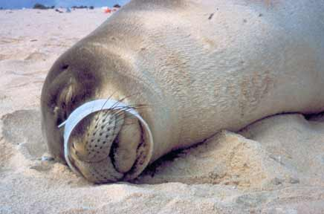
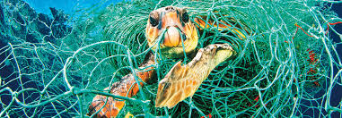
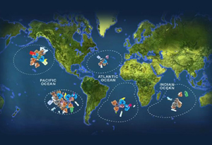
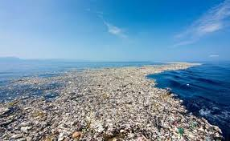
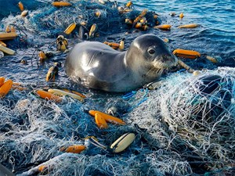
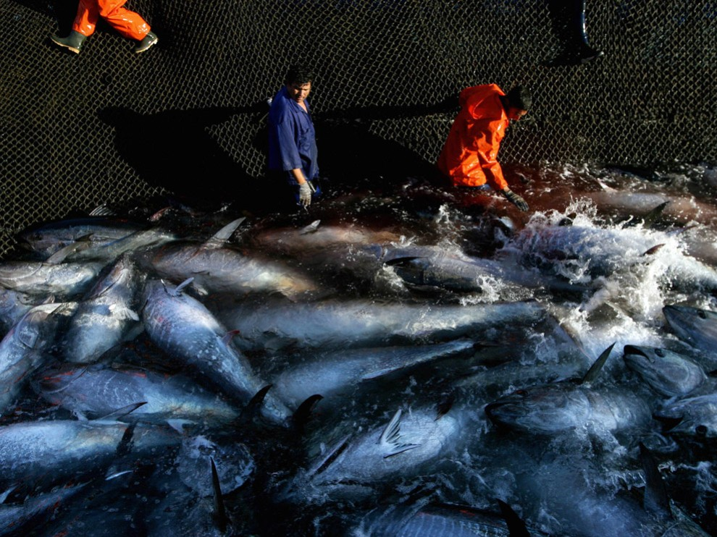
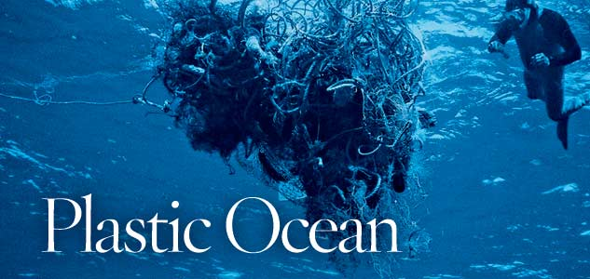
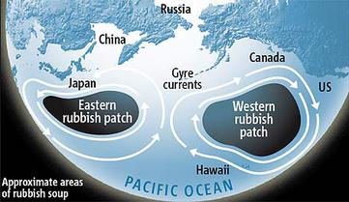
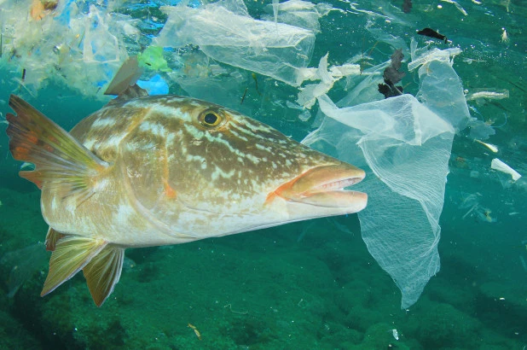
Every year, 8 million metric tons of plastics enter our ocean on top of the estimated 150 million metric tons that currently circulate our marine environments.
About 4 million to 12 million metric tons of plastic washed offshore in 2010 alone
Notes:
The scientists figure roughly 15% to 40% of littered or dumped plastic enters the ocean each year. Adding together all 192 countries in the world with a significant coastal population, the researchers report online today in Science that
about 4 million to 12 million metric tons of plastic washed offshore in 2010 alone, or about 1.5% to 4.5% of the world’s total plastic production—enough to cover every foot of coastline on the planet. That’s just the beginning of the problems, the team says, as scientists still don’t know where more than 99% of ocean plastic debris ends up—and what impact it’s having on marine life and the human food supply. What’s more, the authors predict that the annual amount of plastic waste tumbling out to sea will more than double in the next 10 years.science
The Great Pacific garbage patch, also described as the Pacific trash vortex, is a gyre of marine debris particles in the central North Pacific Ocean located roughly between 135°W to 155°W and 35°N and 42°N.^{[1]} The patch extends over an indeterminate area, with estimates ranging very widely depending on the degree of plastic concentration used to define the affected area.
The patch is characterized by exceptionally high relative concentrations of pelagic plastics, chemical sludge and other debris that have been trapped by the currents of the North Pacific Gyre.^{[2]} Despite its enormous size and density (4 particles per cubic meter), the patch is not visible from satellite photography, nor is it necessarily detectable to casual boaters or divers in the area, as it consists primarily of a small increase in suspended, often microscopic particles in the upper water column.
The size of the patch is unknown, as large items readily visible from a boat deck are uncommon. Most debris consists of small plastic particles suspended at or just below the surface, making it impossible to detect by aircraft or satellite. Instead, the size of the patch is determined by sampling. Estimates of size range from 700,000 square kilometres (270,000 sq mi) (about the size of Texas) to more than 15,000,000 square kilometres (5,800,000 sq mi) (0.41% to 8.1% of the size of the Pacific Ocean), or, in some media reports, up to "twice the size of the continental United States".[

Slide 25
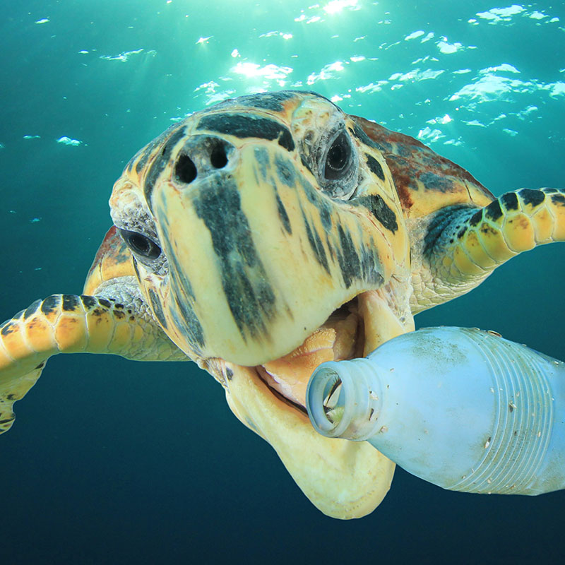

Slide 26
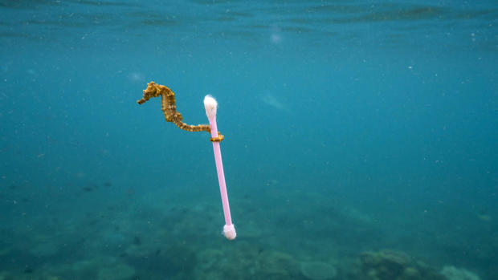

Slide 27
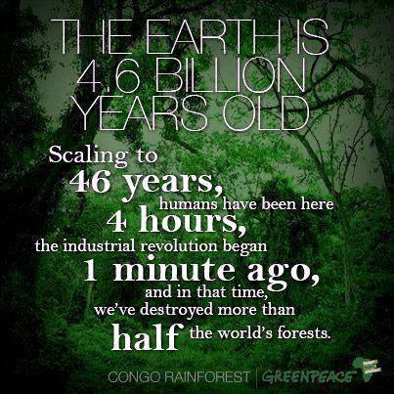

Slide 28
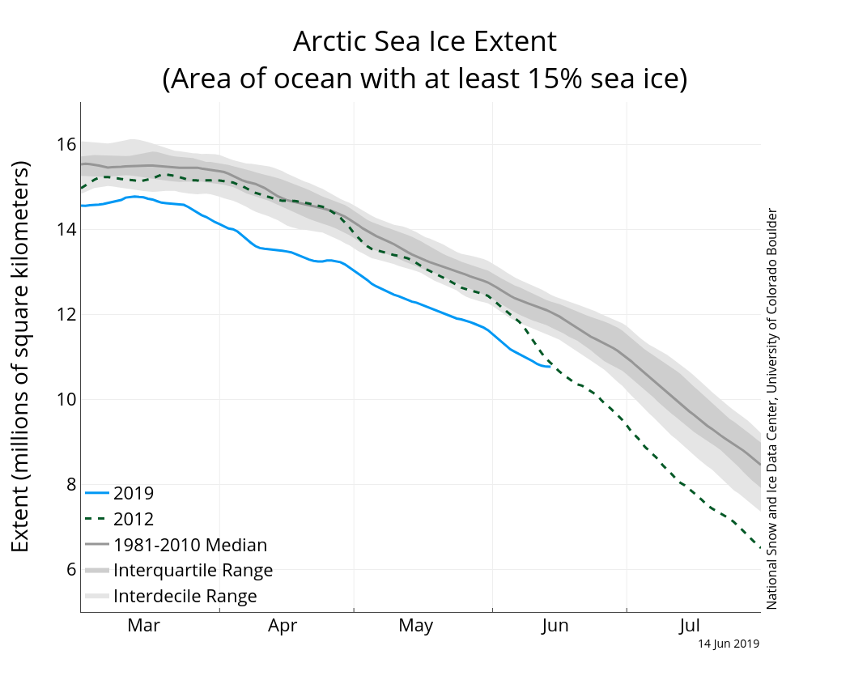

Slide 29
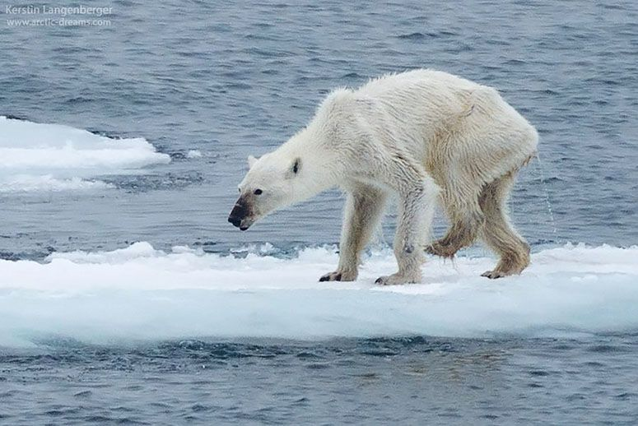

Slide 30
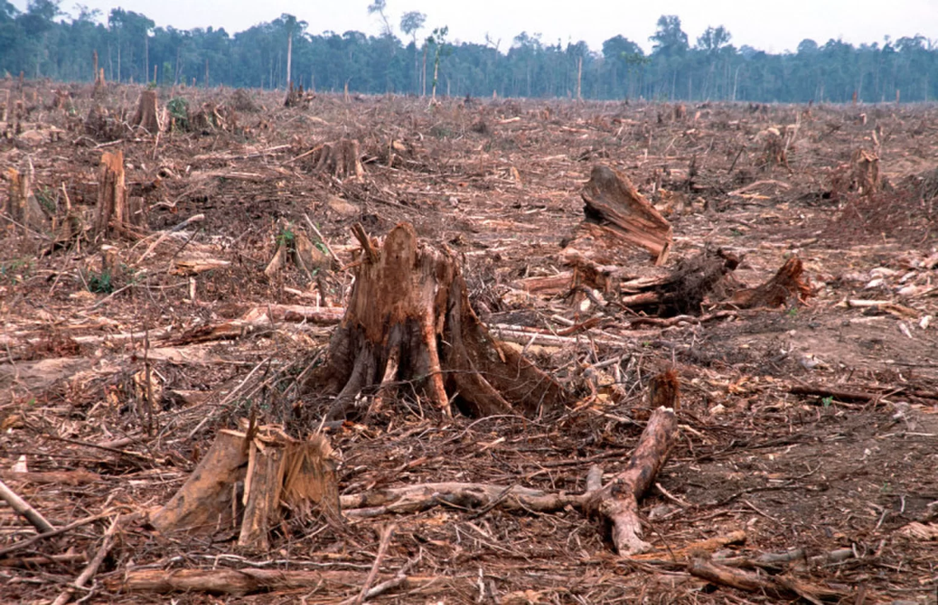

Slide 31
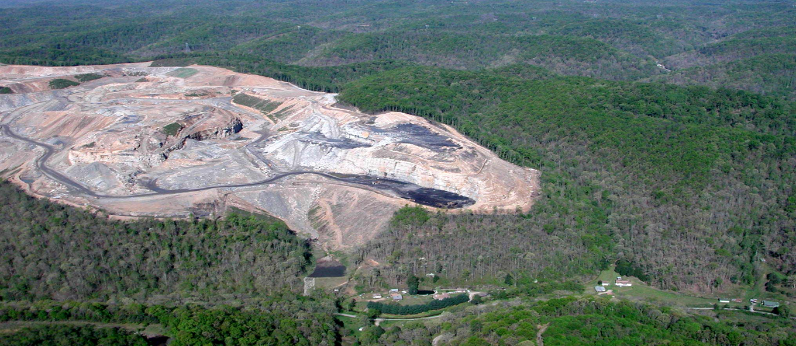

Slide 32
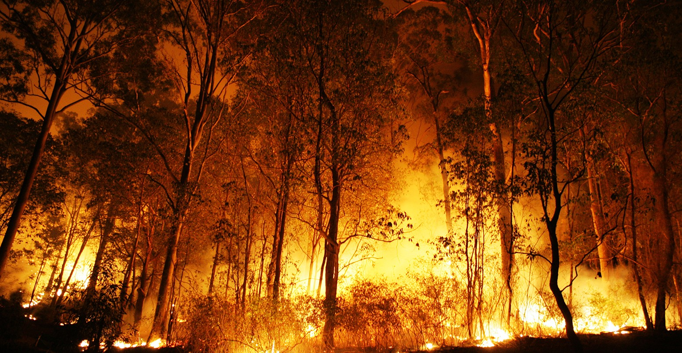

Slide 33
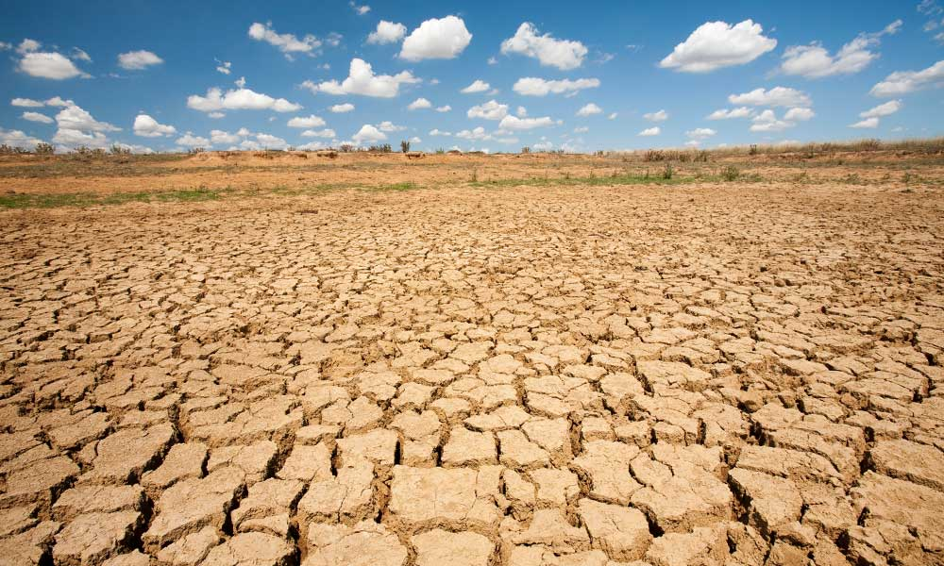

Slide 34
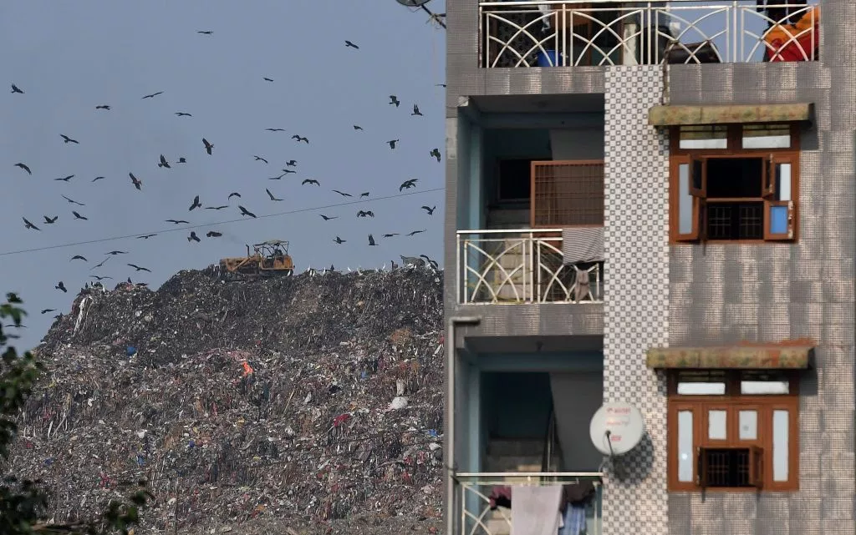

Slide 35
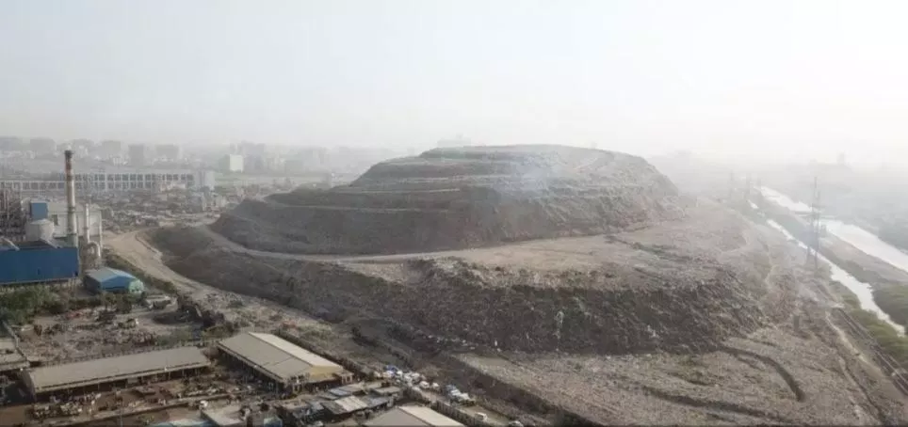

Slide 36
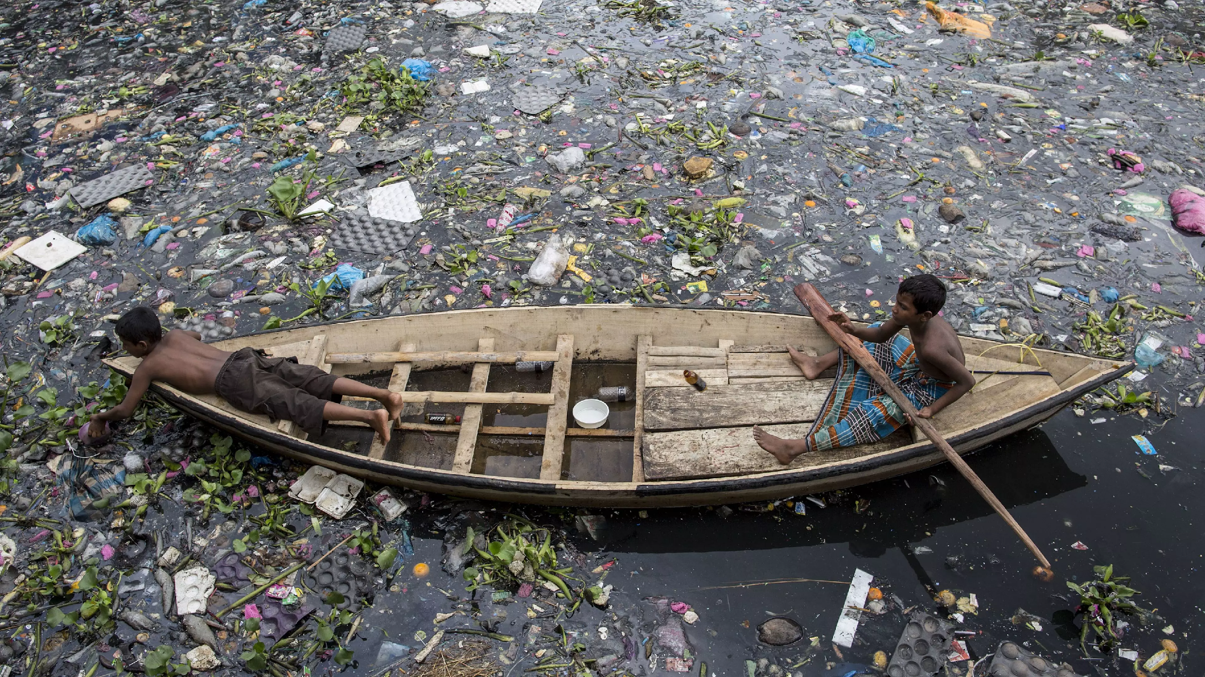

Slide 37
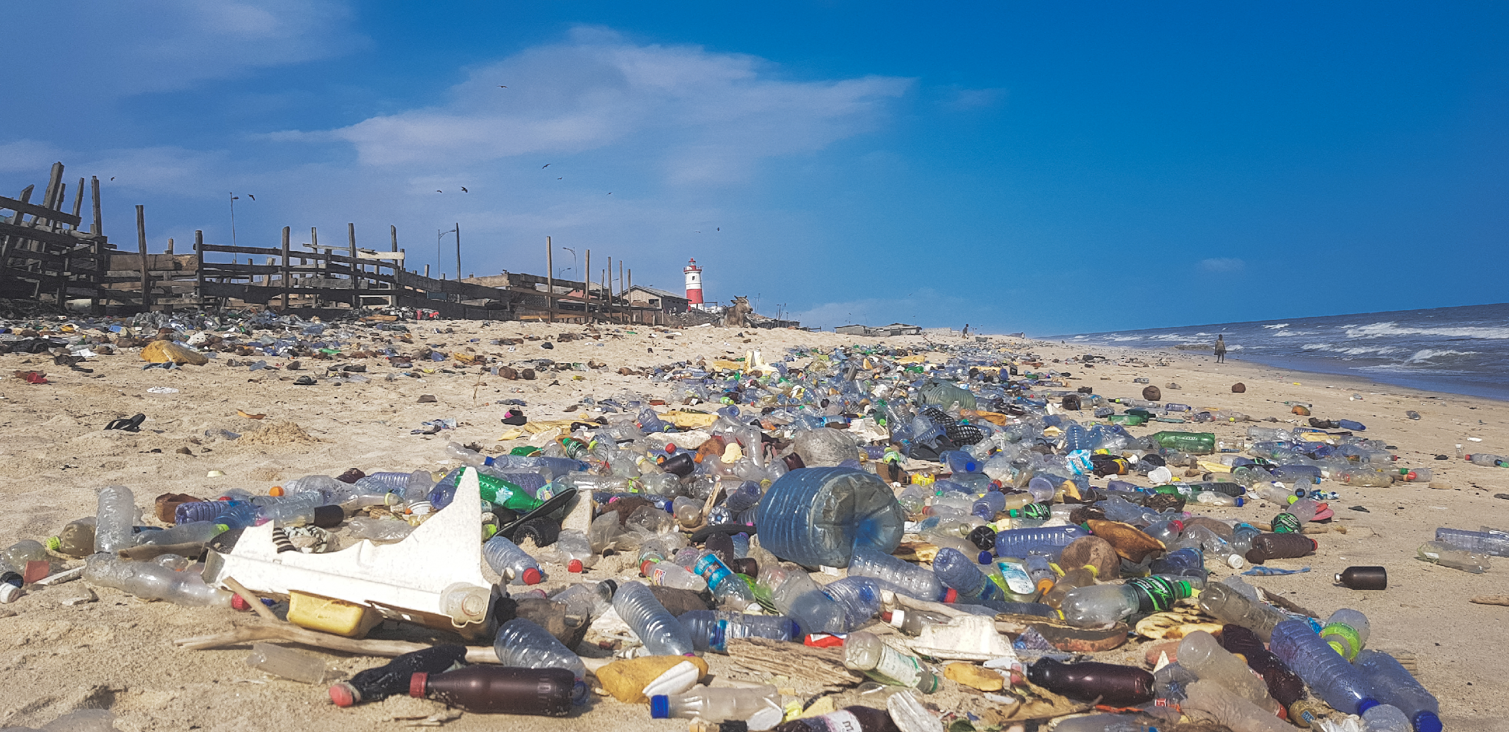

Slide 38
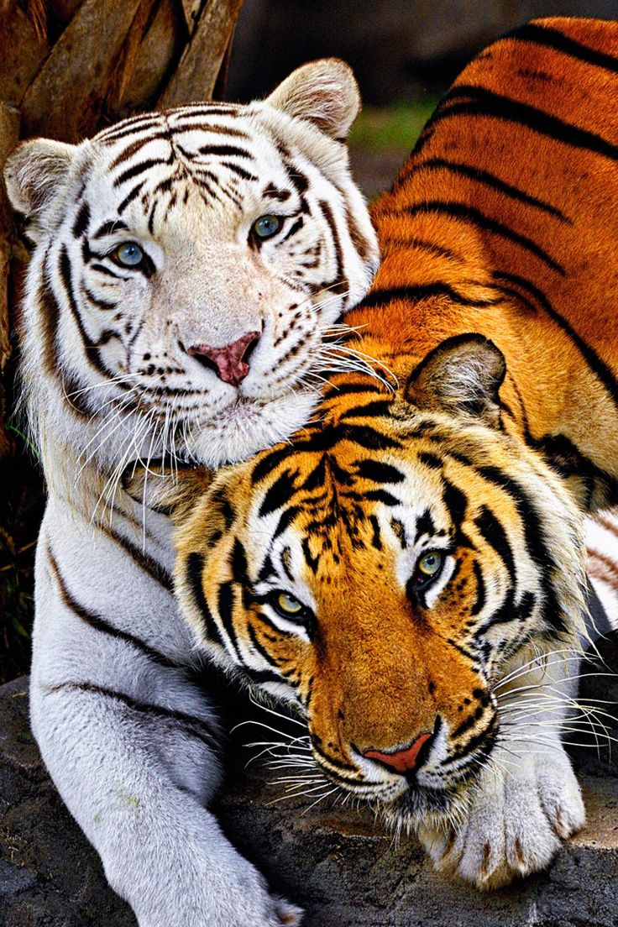
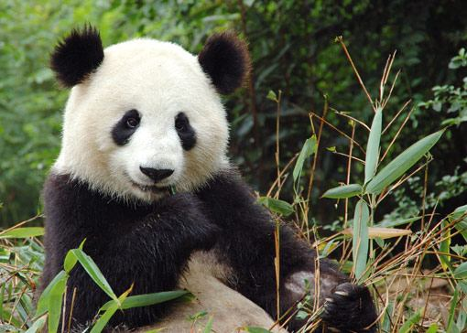
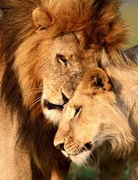
There are numerous species currently in danger of extinction. Most of them are caused directly or indirectly by humans; e.g., climate change, destruction of their habitat, illegal hunting, etc.

Slide 39
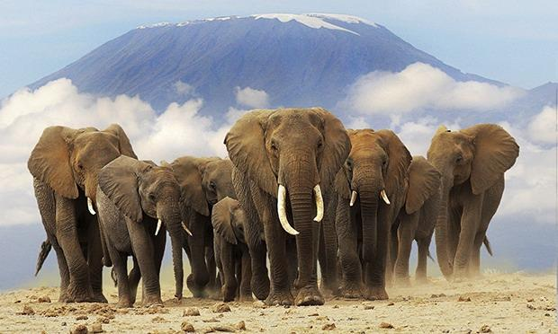
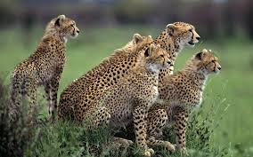
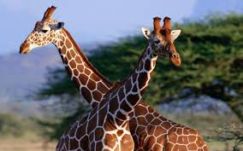
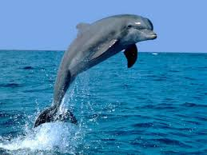
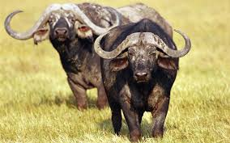
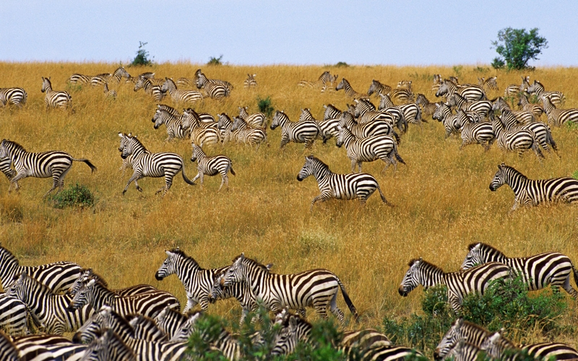
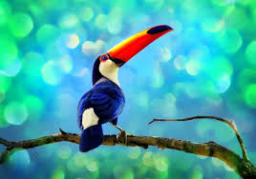
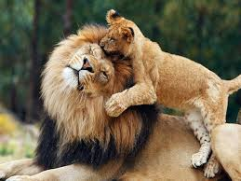
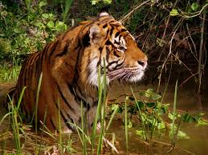
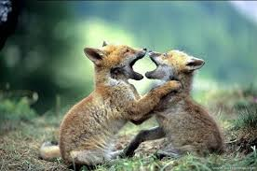
World wildlife populations halved in 40 years…
Notes:
Science and environmentbbc news

Slide 40
Your Despair
Notes:
In pairs, closed eyes exercise - share

Slide 41
Martin begins here

Slide 42
Joanna Macey – the work that reconnects
"Things I love about our world include...”
"Concerns I have about our world include...”
"A perspective I find inspiring or refreshing is...”
"Steps I can take to participate in the Great Turning include..."
Notes:
Show website

Slide 43
From:
I,
here,
now
Place our joy - or a lived sense of valuing - here

Slide 44
From:
I,
here,
now
Our grief, loss, despair,
Helplessness, guilt
Placing our joy - or our lived sense of valuing - here

Slide 45
Experiential Avoidance
Not only would we have to open up to this kind of pain, we’d also have to admit our role in it. Acceptance would require:
Admitting to a whole set of factual limitations concerning our lives…and this reality feels constricting.
Contemplating / being with the extreme discomfort that arises when scientists tell us about the devastation and hardship that global warming will inevitably cause. (implicative denial)

Slide 46
Denial, avoidance, distraction, frantic workaholic activity, addictive numbing
From:
I,
here,
now
Our grief, loss, despair,
Helplessness, guilt
Placing our joy - or our lived sense of valuing - here

Slide 47
Joanna Macey – the work that reconnects
"Things I love about our world include...”
"Concerns I have about our world include...”
"A perspective I find inspiring or refreshing is...”
"Steps I can take to participate in the Great Turning include..."
Notes:
Show website

Slide 48
And from a refreshing, inspiring perspective?
The integral perspective - Ken Wilber
The Gaia theory - James Lovelock, Lynn Margulis
The Ecological Self - Arne Ness, Joanna Macy

Slide 49
Methodological pluralism
4 quadrants of integral framework

Slide 53
The Gaia hypothesis.
Conceived by the British chemist James Lovelock in the early 1970s and later developed with the American biologist Lynn Margulis, the Gaia hypothesis proposes that all the living and nonliving elements of Earth are “parts and partners of a vast being who in her entirety has the power to maintain our planet as a fit and comfortable habitat for life.”
Notes:
CFC’s – Lynn Margulis
Gaia Theory argues that we are far more than just the “Third Rock from the Sun,” situated precariously between freezing and burning up. The theory asserts that living organisms and their inorganic surroundings have evolved together as a single living system that intimately affects the chemistry and conditions of Earth’s surface. Some systems scientists believe that this “Gaian system” self-regulates global temperature, atmospheric content, ocean salinity, and other factors in an “automatic” manner. Earth’s living system appears to keep conditions on our planet just right for life to persist!

Slide 54
Denial, avoidance, distraction, frantic workaholic activity, addictive numbing
From:
(global us) Gaia
here,
now
Our grief, loss, despair,
Helplessness, guilt
Placing our joy - or our lived sense of valuing - here

Slide 55
“Evolution is no linear family tree, but change in the single multidimensional being that has grown to cover the entire surface of Earth.”
– From “What is Life?” 1995. By Lynn Margulis

Slide 56
Naomi Klein (“This changes everything”, 2014)
“ ….the bottom line is what matters here: our economic system and our planetary system are now at war. Or more accurately, our economy is at war with many forms of life on earth, including human life. What the climate needs to avoid collapse is a contraction in humanity’s use of resources; what our economic model demands to avoid collapse is unfettered expansion. Only one set of these rules can be changed.

Slide 57
Guided Meditation: The Ecological Self
Notes:
In pairs, closed eyes exercise - share

Slide 58
PPT Input on:
Rittells Wicked problems
Elinor Ostrums group design principles
And the 4R’s of Deep adaptation (Jem Bendell)
In preparation for “Going forth” - or as we might say “Committed Actions in the service of ecological values recognised from the perspective of the ecological self.

Slide 59
The “commons”|
Earth as Context
Plants
Animals
Humans
We are not separate, but interrelated

Slide 60
Going forth - what is to be done?
Groups of 4, unstructured sharing re ecological values and potential committed actions: personal and organisational - for eg - what can ACBS do? My family, my club, how might I adapt my therapy? Dare I speak of this on social media?

Slide 61
The six wicked complexifiers

Slide 62
Paul starts here

Slide 63
Prosocial
Notes:
Prosocial behavior, or "voluntary behavior intended to benefit another",^{[1]} is a social behavior that "benefit[s] other people or society as a whole,"^{[2]} "such as helping, sharing, donating, co-operating, and volunteering."^{[3]}
These actions may be motivated by empathy and by concern about the welfare and rights of others,^{[4]} as well as for egoistic or practical concerns.^{[1]} Evidence suggests that prosociality is central to the well-being of social groups across a range of scales.^{[5][6]} Empathy is a strong motive in eliciting prosocial behavior, and has deep evolutionary roots.^{[7]}
Prosocial behavior fosters positive traits that are beneficial for children and society. It may be motivated both by altruism and by self-interest, for reasons of immediate benefit or future reciprocity. Evolutionary psychologists use theories such as kin-selection theory and inclusive fitness as an explanation for why prosocial behavioral tendencies are passed down generationally, according to the evolutionary fitness displayed by those who engaged in prosocial acts.^{[8]} Encouraging prosocial behavior may also require decreasing or eliminating undesirable social behaviors.^{[6]}
Empathy is a strong motive in eliciting prosocial behavior, and has deep evolutionary roots.^{[7]}
Prosocial behavior fosters positive traits that are beneficial for children and society. It may be motivated both by altruism and by self-interest, for reasons of immediate benefit or future reciprocity. Evolutionary psychologists use theories such as kin-selection theory and inclusive fitness as an explanation for why prosocial behavioral tendencies are passed down generationally, according to the evolutionary fitness displayed by those who engaged in prosocial acts.^{[8]}.^{[6]}

Slide 64
Setting Your Intention Exercise
Notes:
Joanna Macey’s work - the ‘Great Turning’
Mapping her 4 stage cyclical process onto matrix (we already do this stuff!)
The integral perspective -
James Lovelock’s Gaia hypothesis as introduction to systems thinking
Shifting perspectives for second spin around matrix -
I, here, now - goes to - Us, here, now
Introducing Elinor Ostrom’s evolutionary design principles and Rittel’s ‘wicked’ problems as cautionary guiding principles before leaping to committed actions (OR wallowing in despair)
The Deep Adaptation perspective

Slide 65
Creating a science more adequate to the challenge of the human condition…
…and the interdependence of all life.
(earth, animal, human)

Slide 67
Links page for further reading/research:
Transition towns movement
CBS warriors FB page
Extinction rebellion
The Climate Psychology Alliance
A Polycentric Approach for Coping with Climate Change - Elinor Ostrum
Wicked and Wise - how to solve the worlds toughest problems (Watkins, Wilber)

